Slide 1
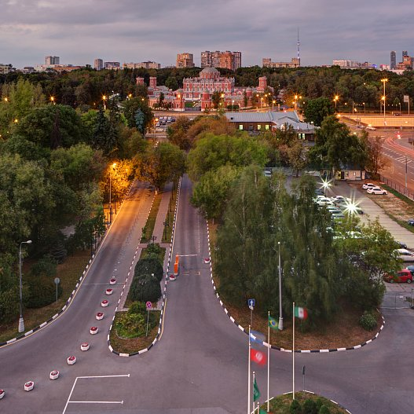
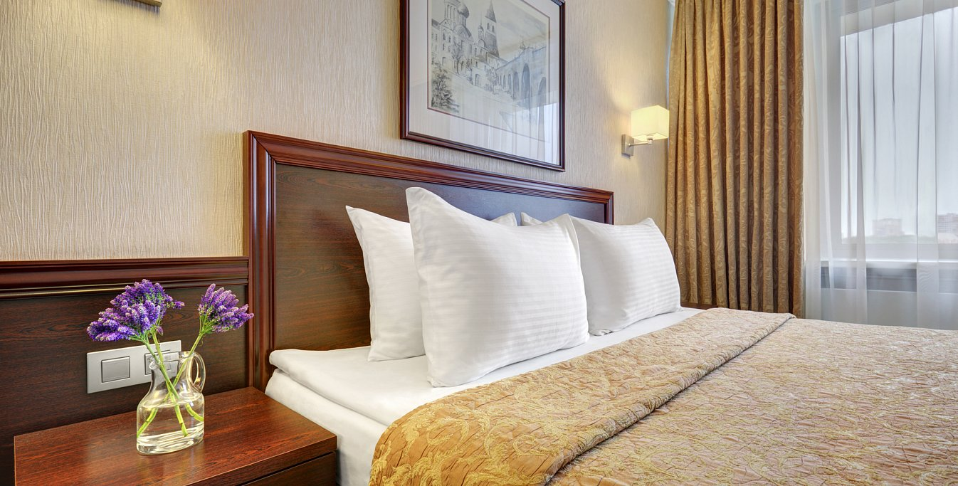
Thank you for choosing our company. We are pleased to invite you to the hotels nearest to the "Gostiny Dvor" in Moscow as part of the Mosshoes exhibition from February 28 to March 03
AEROSTAR Hotel 4*(Dynamo ms)
АЭРОСТАР 4* (ст.м Динамо)
Standard Single/Double | 5200/5900 rub. | Breakfast

Slide 2
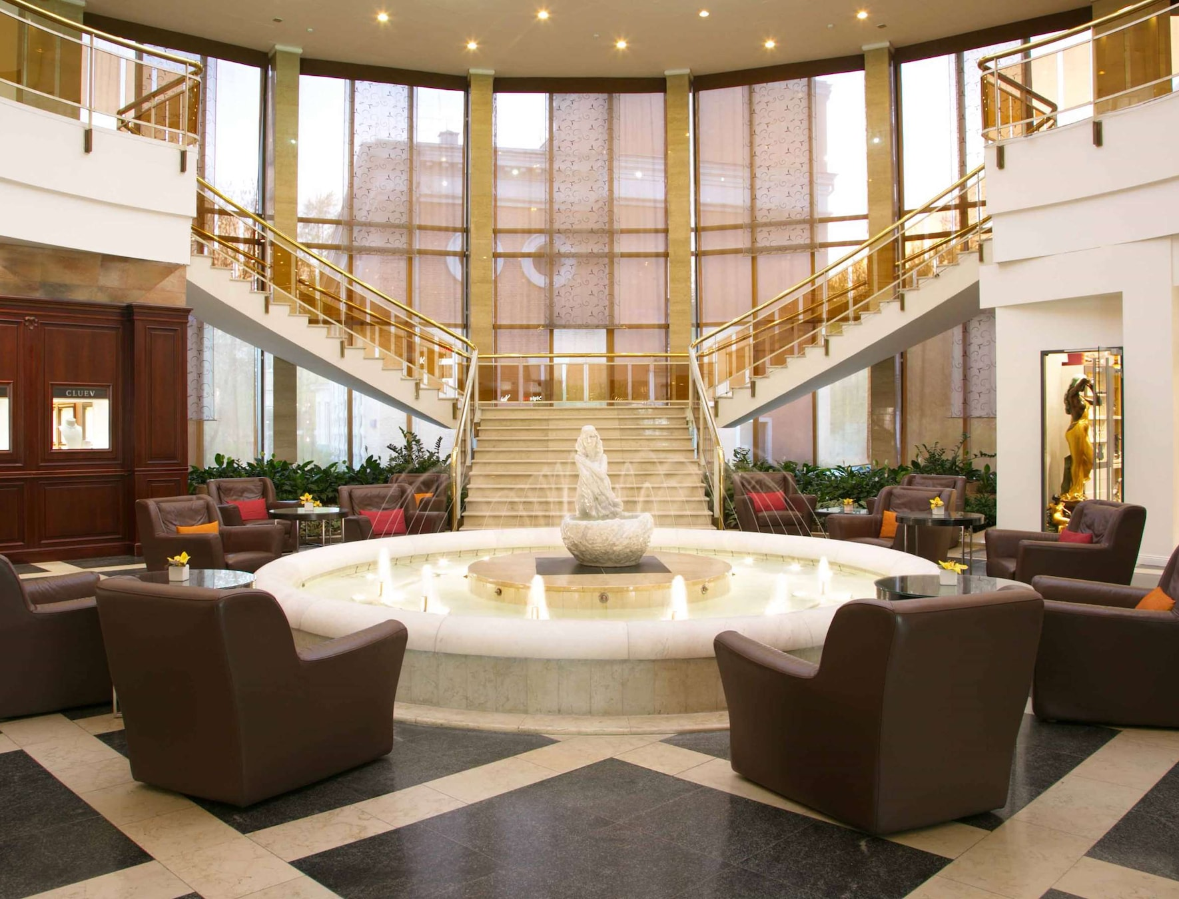
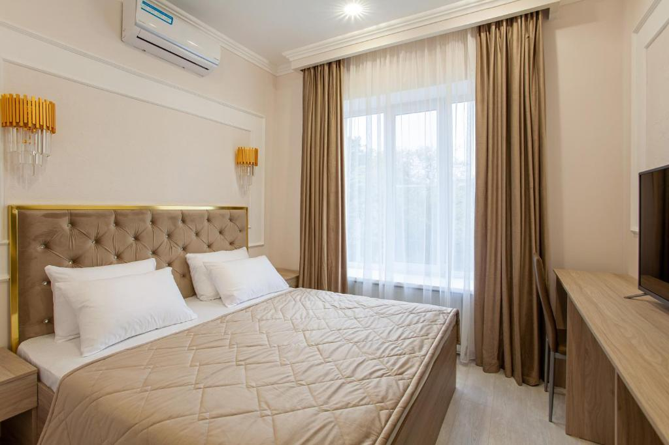
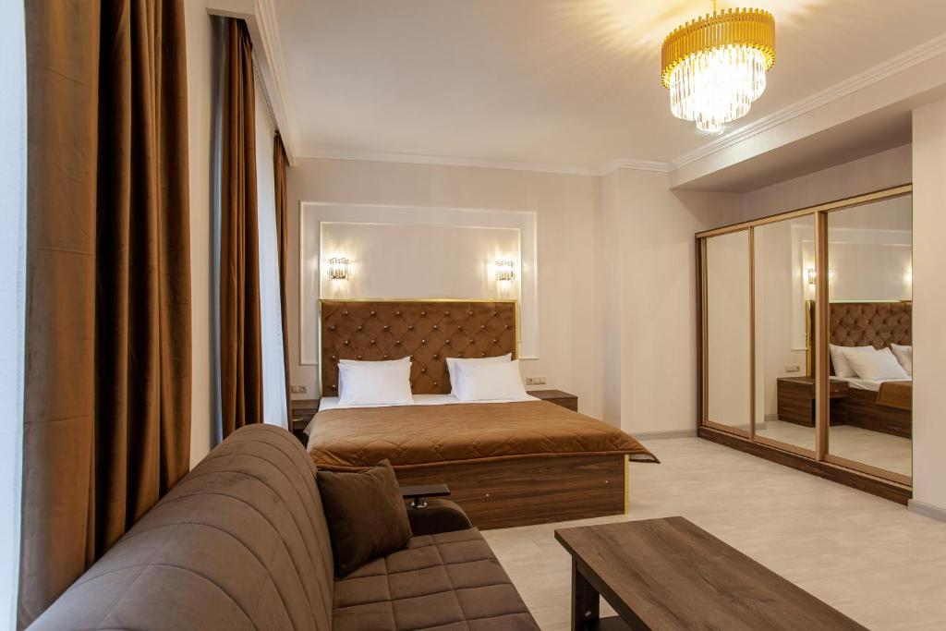
Hotel "Arion" Avtozavodskaya str., 1 (Avtozavodskaya metro station, Dubrovka )
Standard Single/Double | 5500/6000 | Breakfast

Slide 3
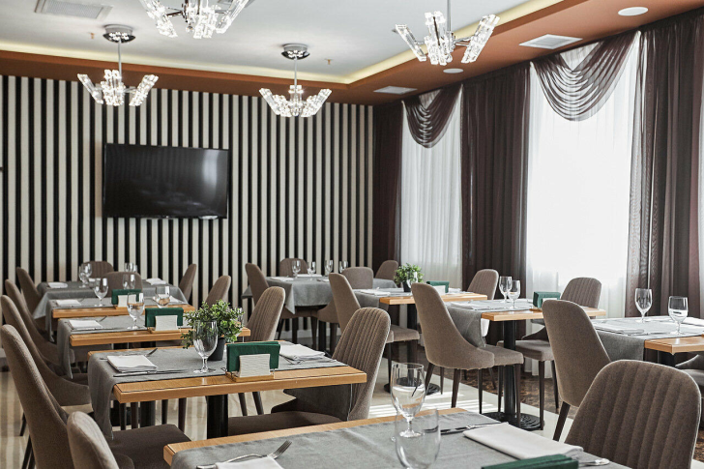
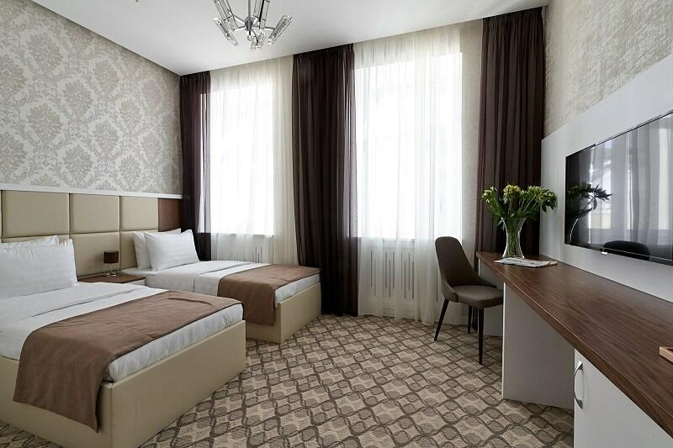
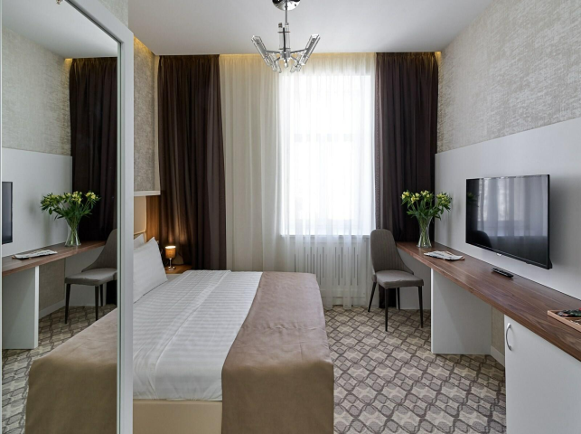
Hotel "Arium" 4* ( m. Chekhovskay, Tverskaya, Pushkinskaya)
Room category | Price single/double occupancy | Breakfast, fitness.
Standard | 6400/7000

Slide 4
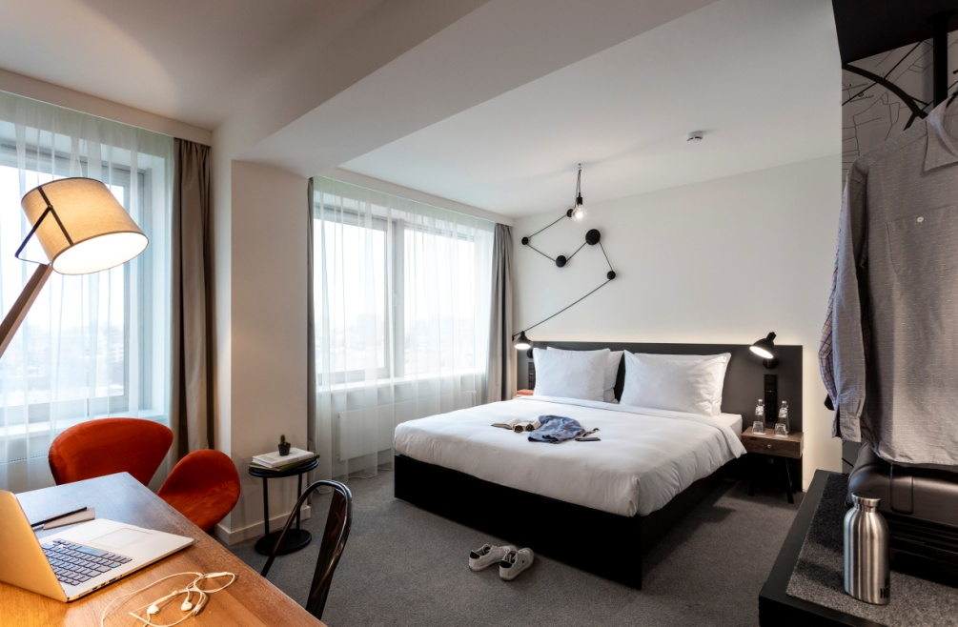
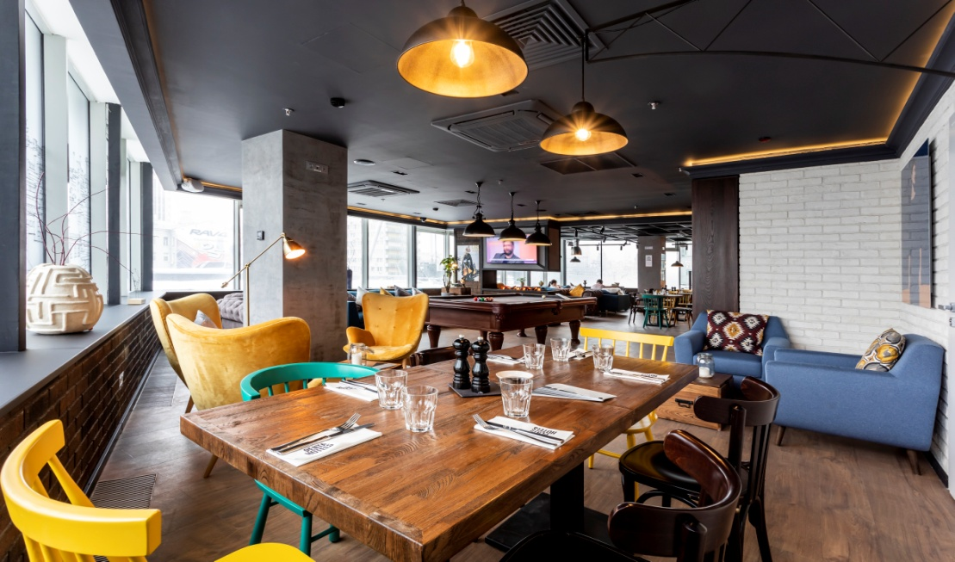
Penta Hotel 4* (Arbatskaya, Smolenskaya)
Standard single/double | 7650/9420 | Breakfast, fitness.
Notes:
Penta Hotel 4* ( Арбатская, Смоленская)

Slide 5
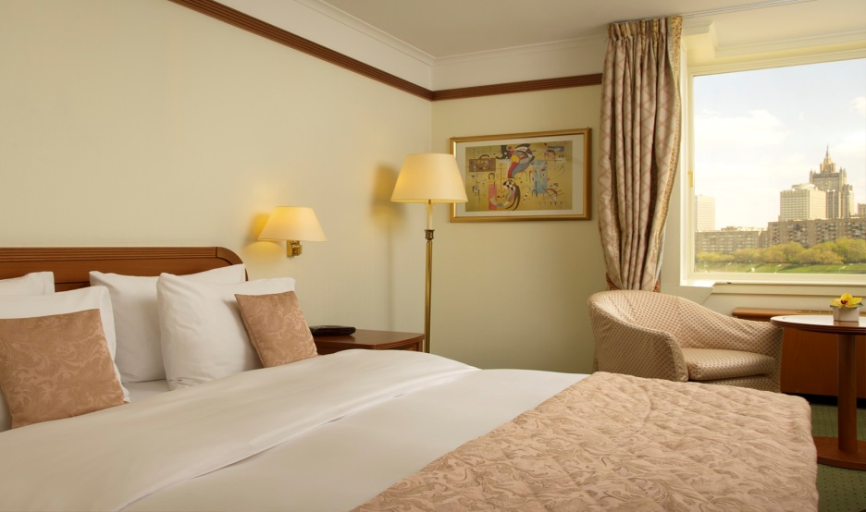
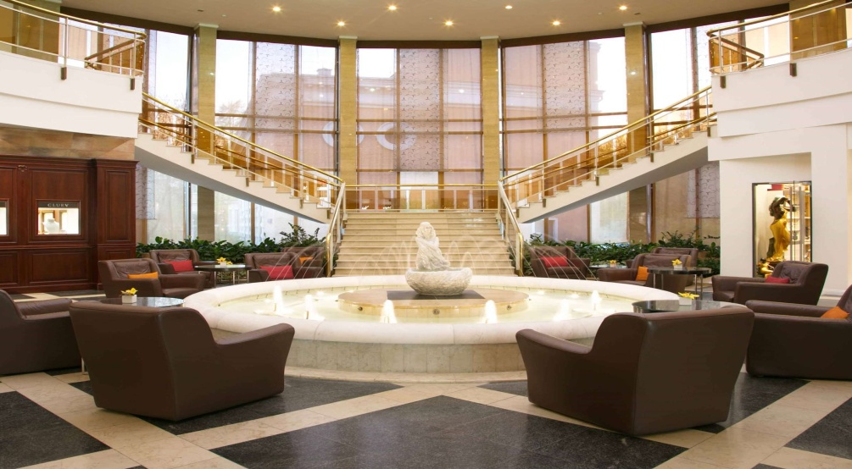
Radisson Sas Slavyanskaya 4* (Europe Square, metro station Kievskaya)
Standard Single/Double | 8200/9040 | Breakfast, fitness, swimming pool

Slide 6
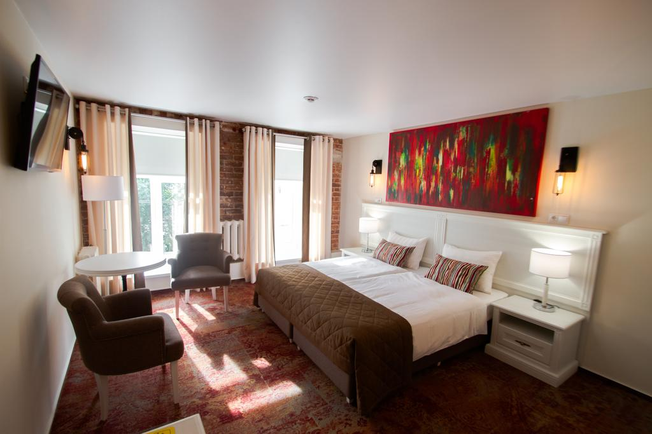
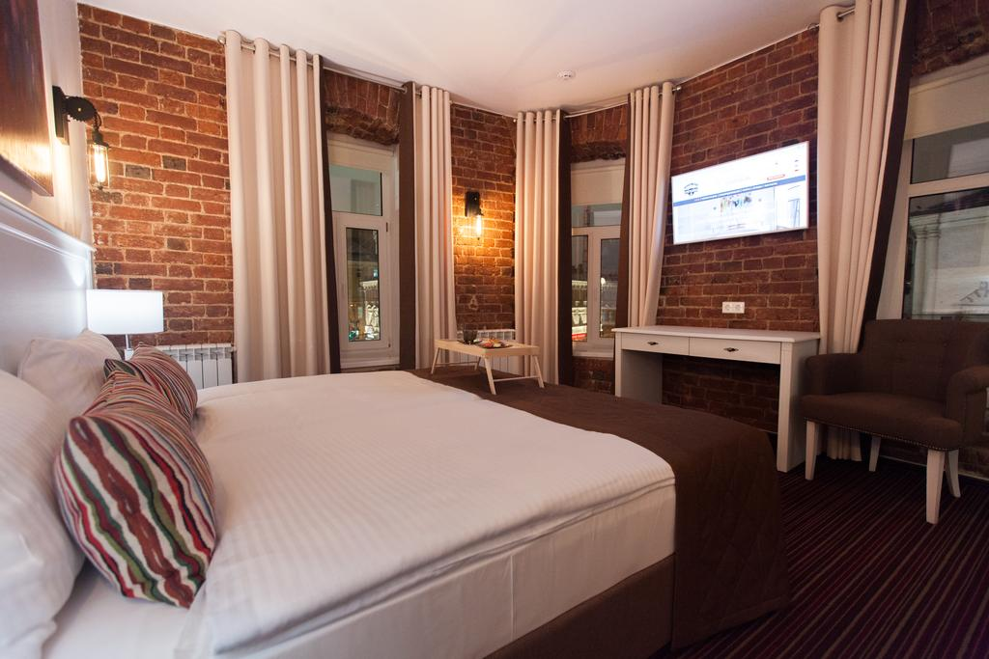
Hotel "NAUMOV" Sretenka str., 1 (metro station Sretensky Boulevard, Turgenevskaya, Chistye Prudy )
Standard Single/Double | 5800/6300 | Breakfast

Slide 7
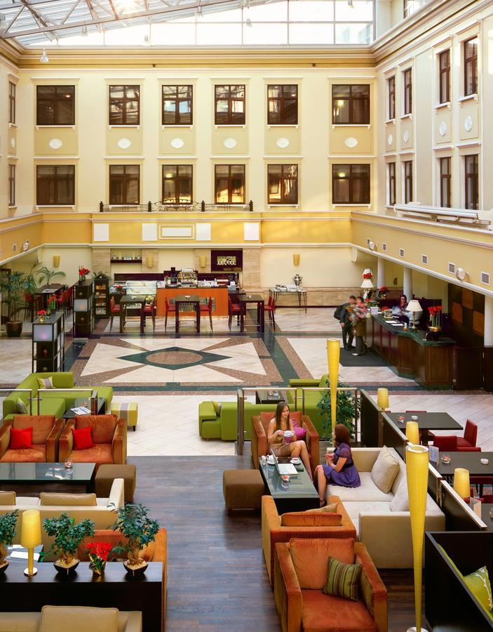
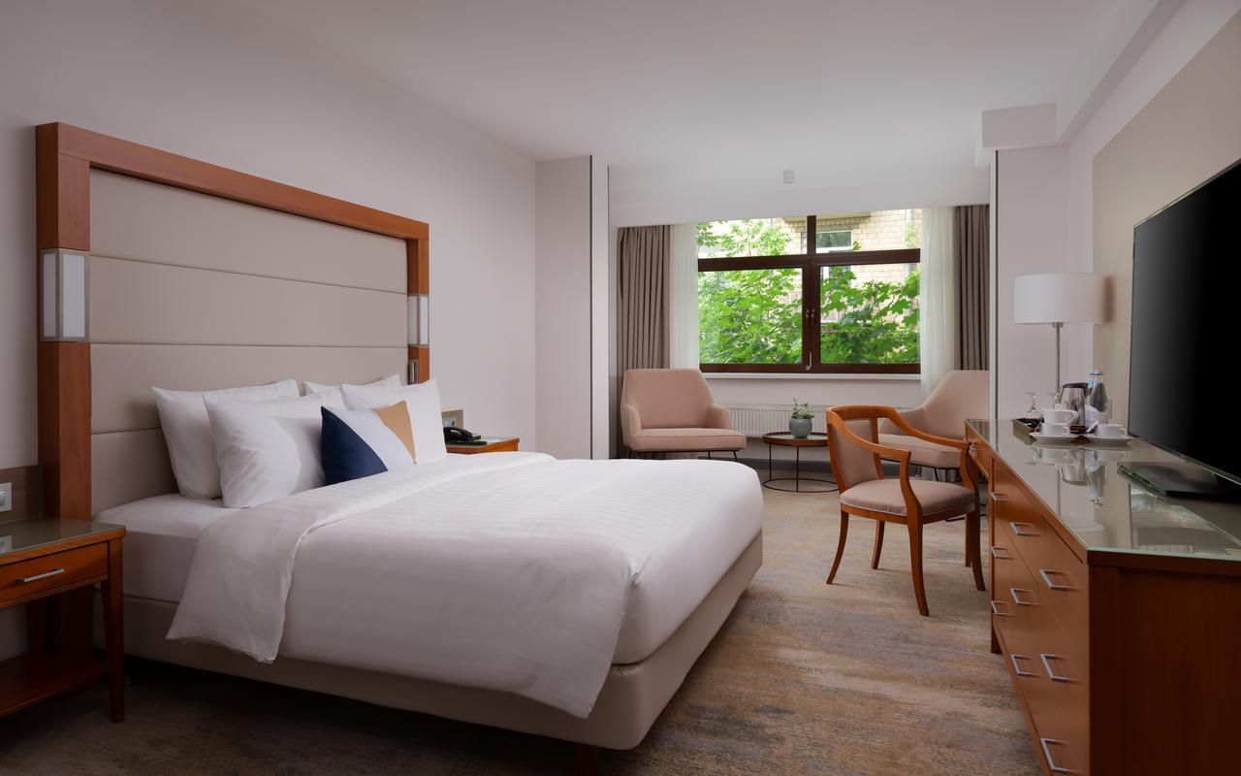
Marriott Courtyard Center 4* (Voznesensky Lane)
Standard Single/Double | 7840 /9200р | Breakfast, fitness

Slide 8
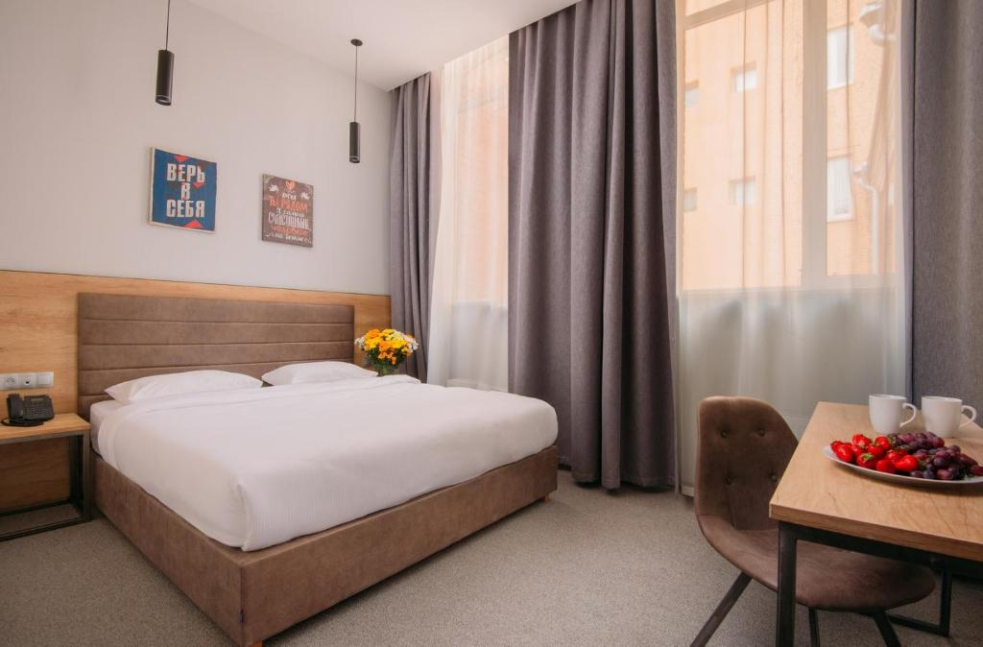
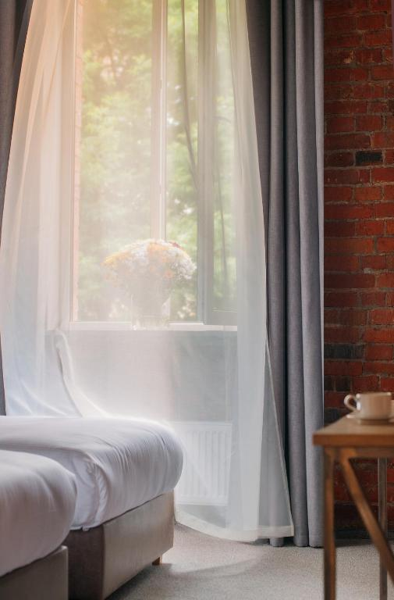
Custos Hotel Lubyansky 4* ( Lubyansky passage, 19)
Standard Single/Double | 7100/7800 | Breakfast

Slide 9
Contacts for hotel reservations and transfers
Konstantin Petrakov
phone ,wtsp +7977-769-73-10
email: kp@3umfs.ru

